Slide 1
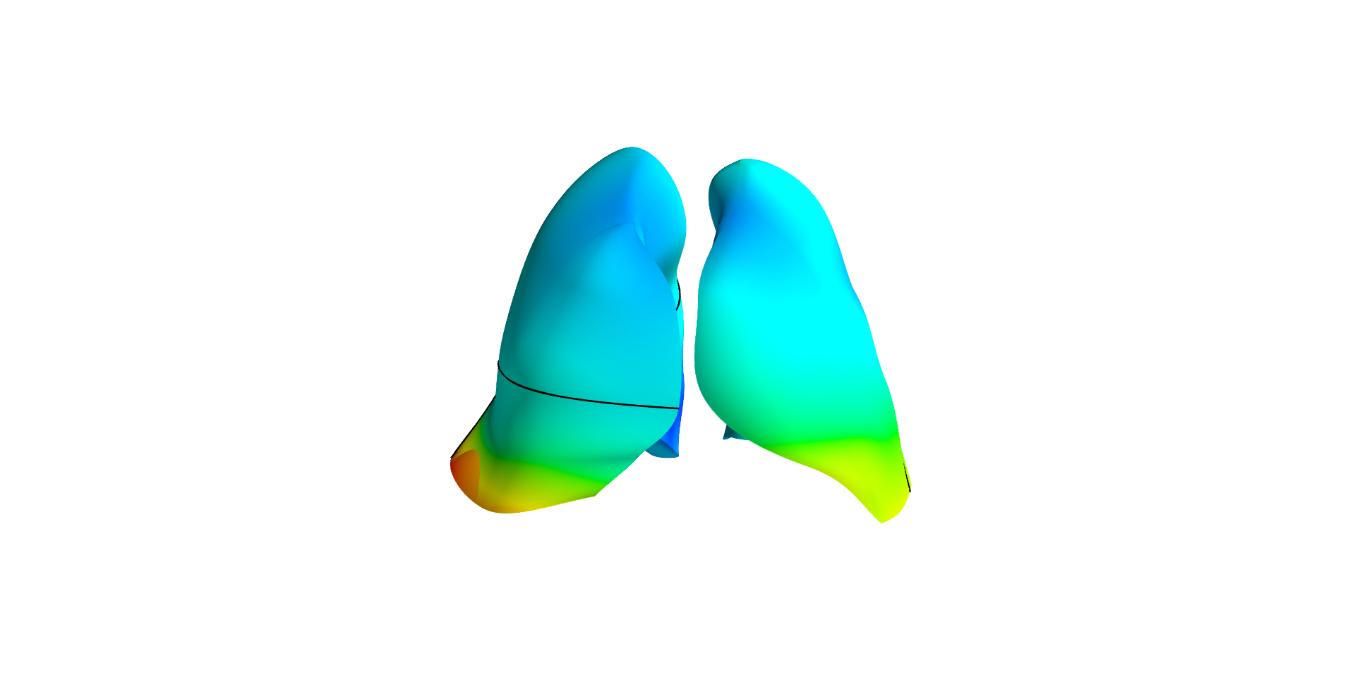
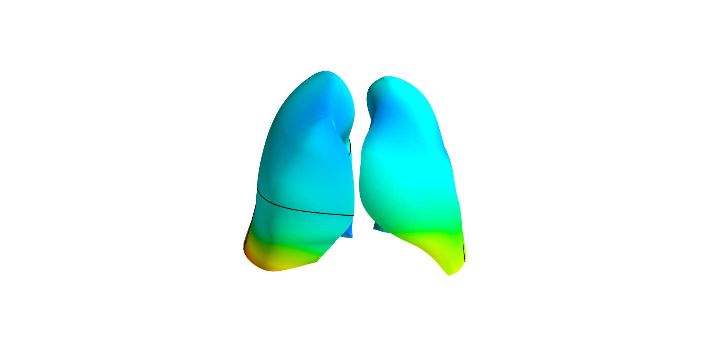
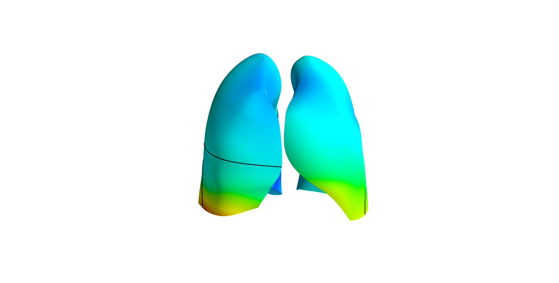
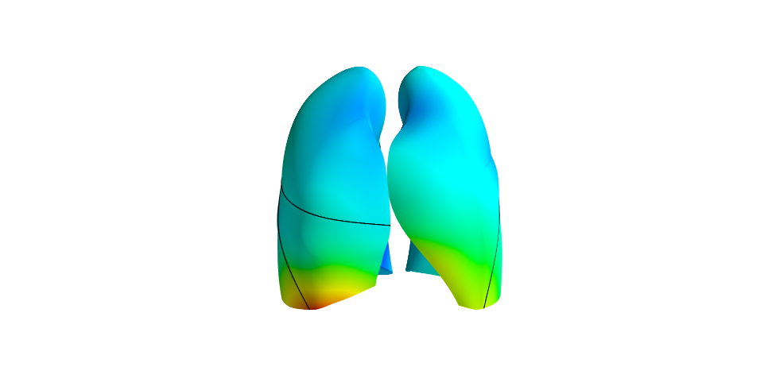
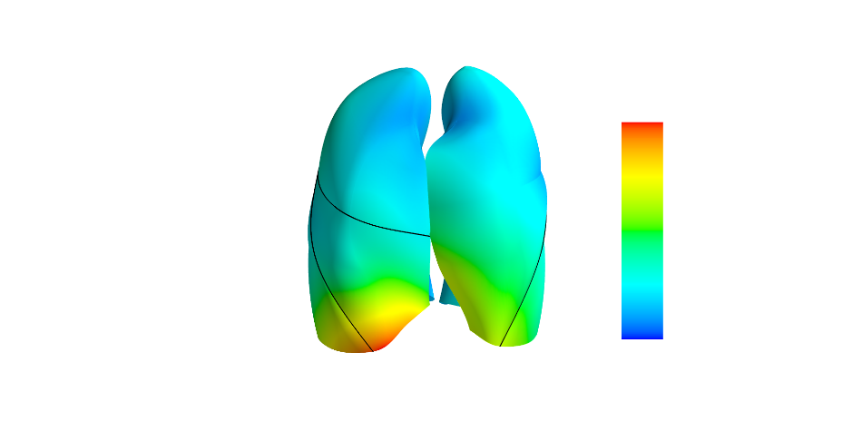
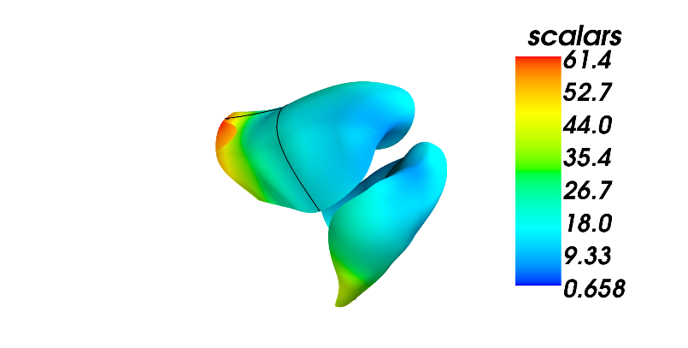
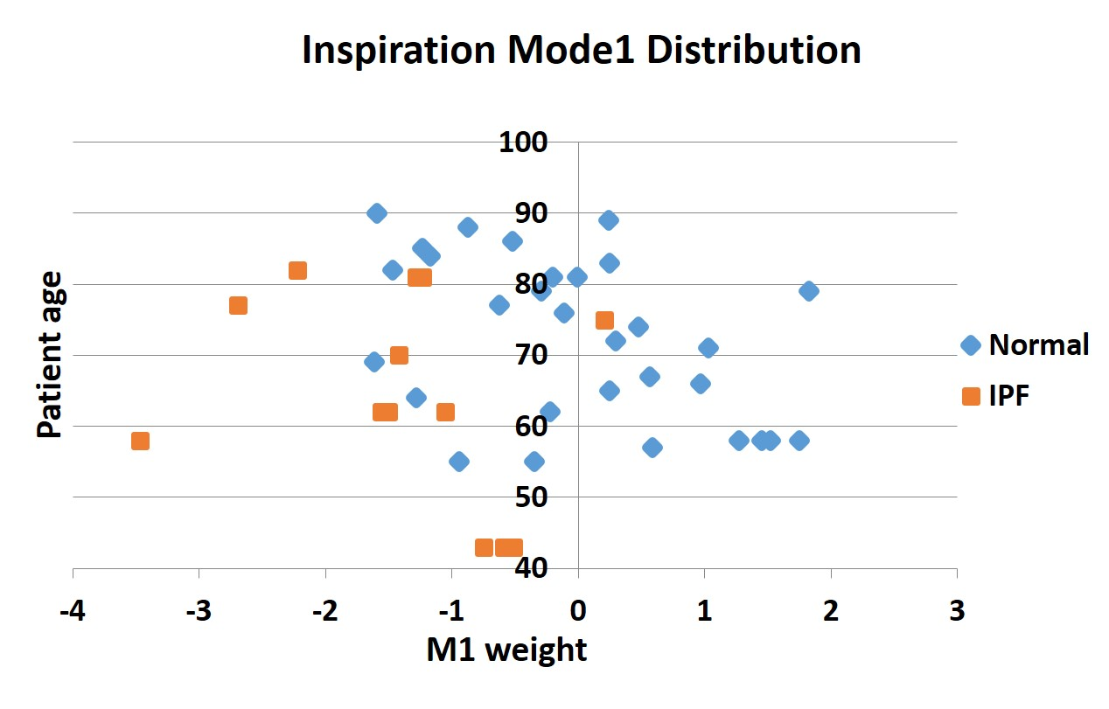
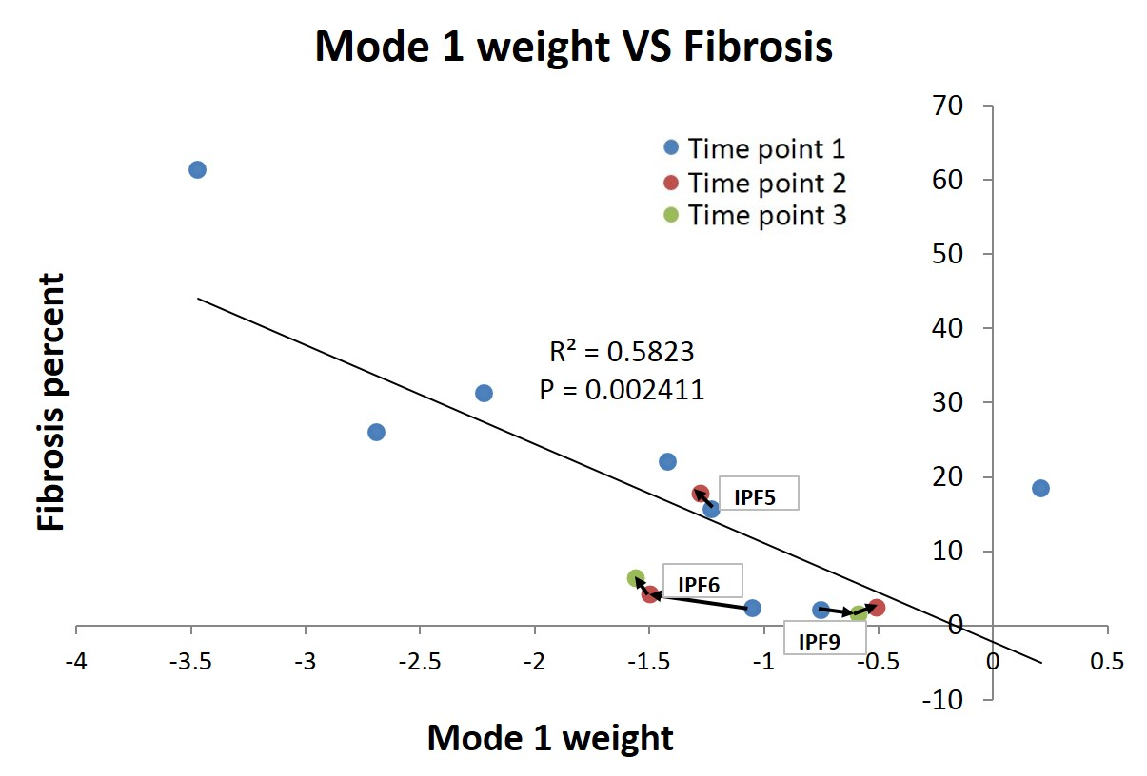
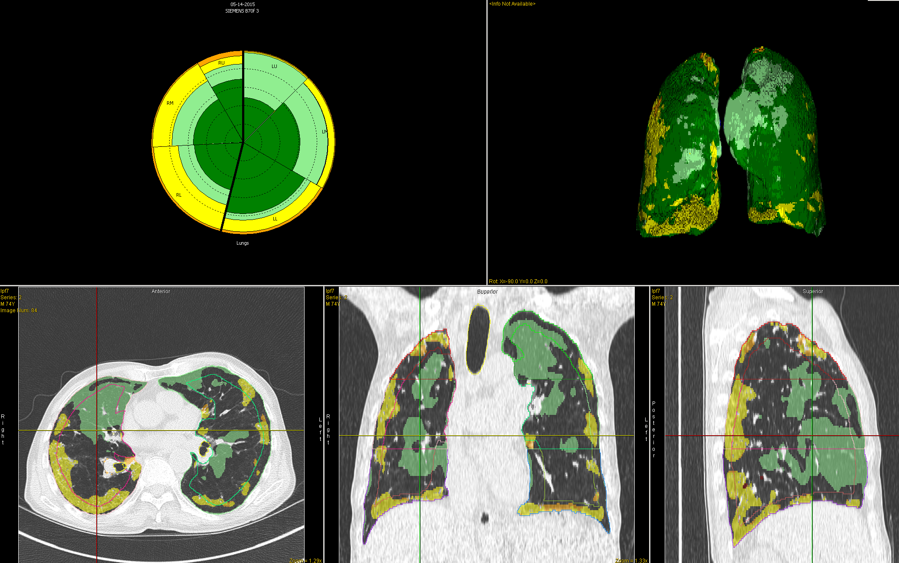
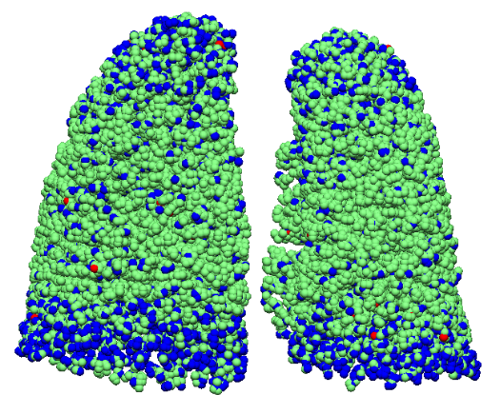
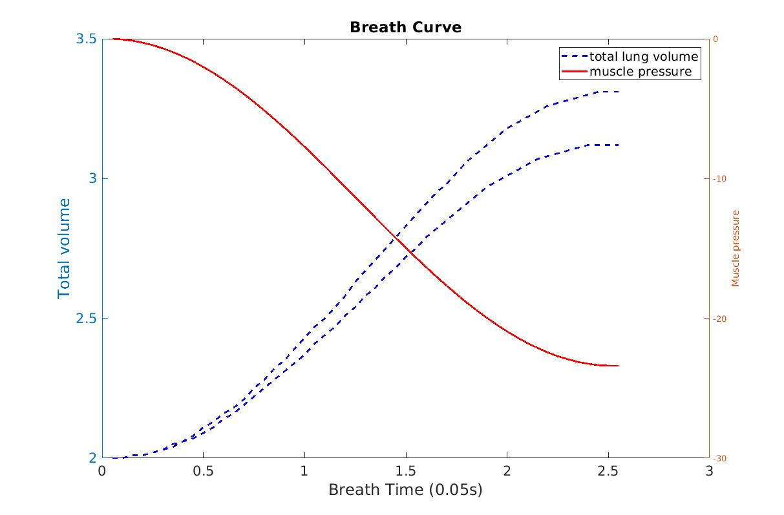
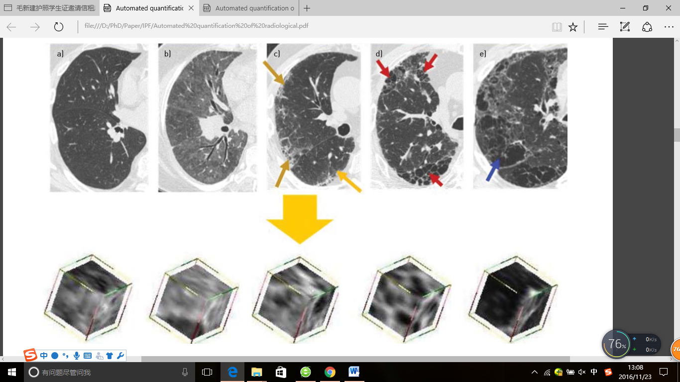
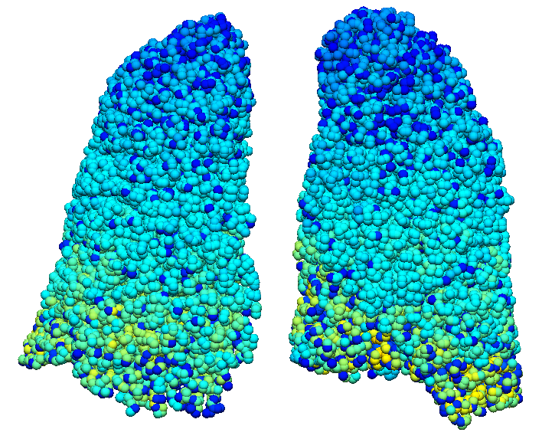
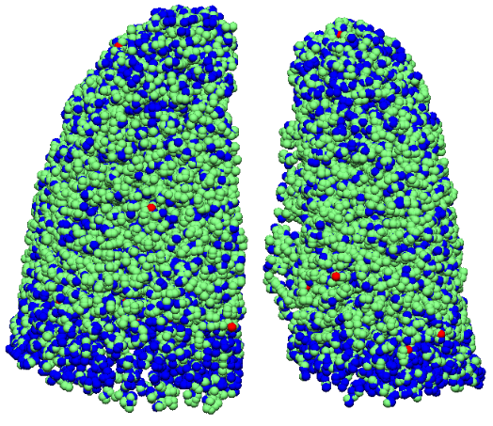
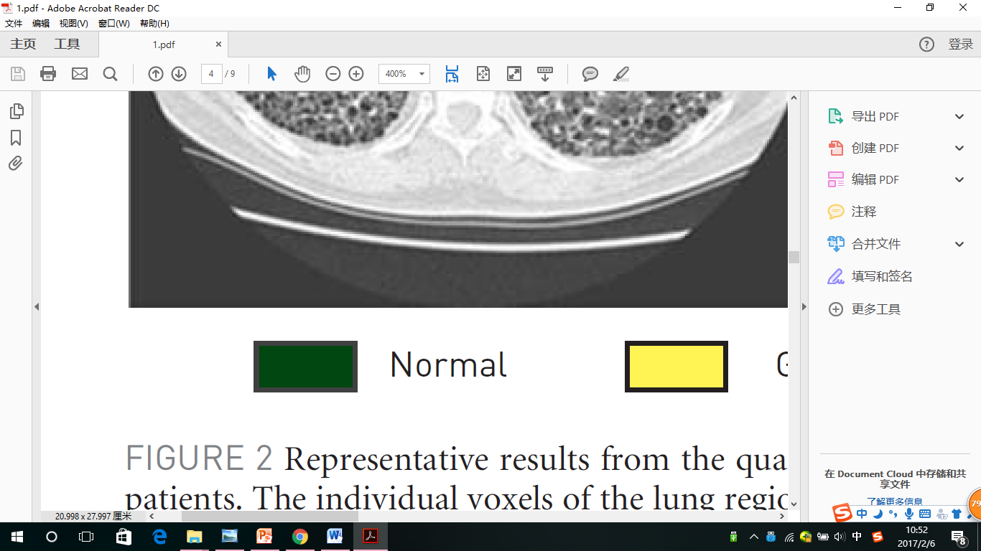
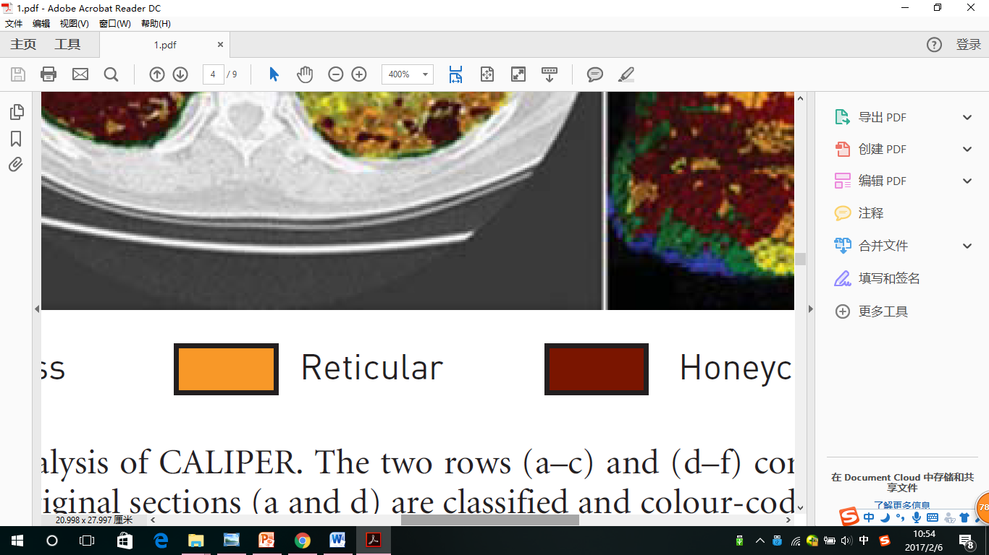
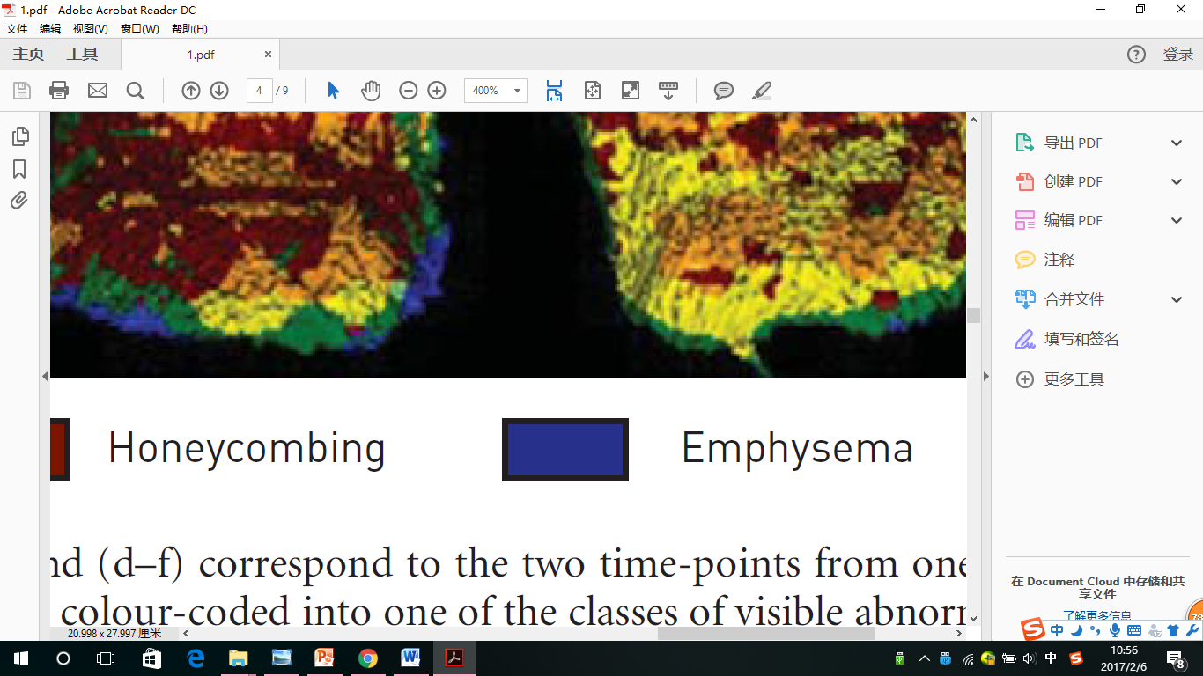
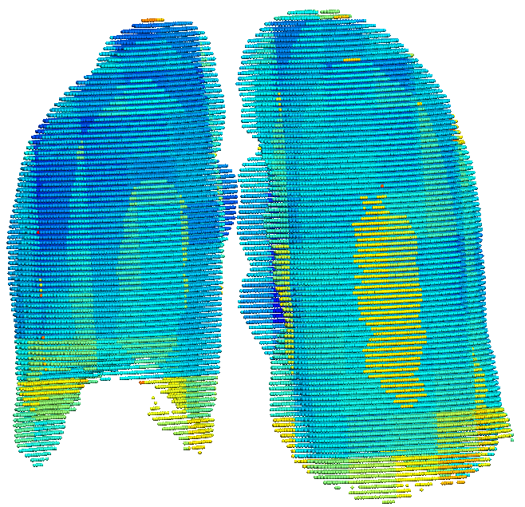
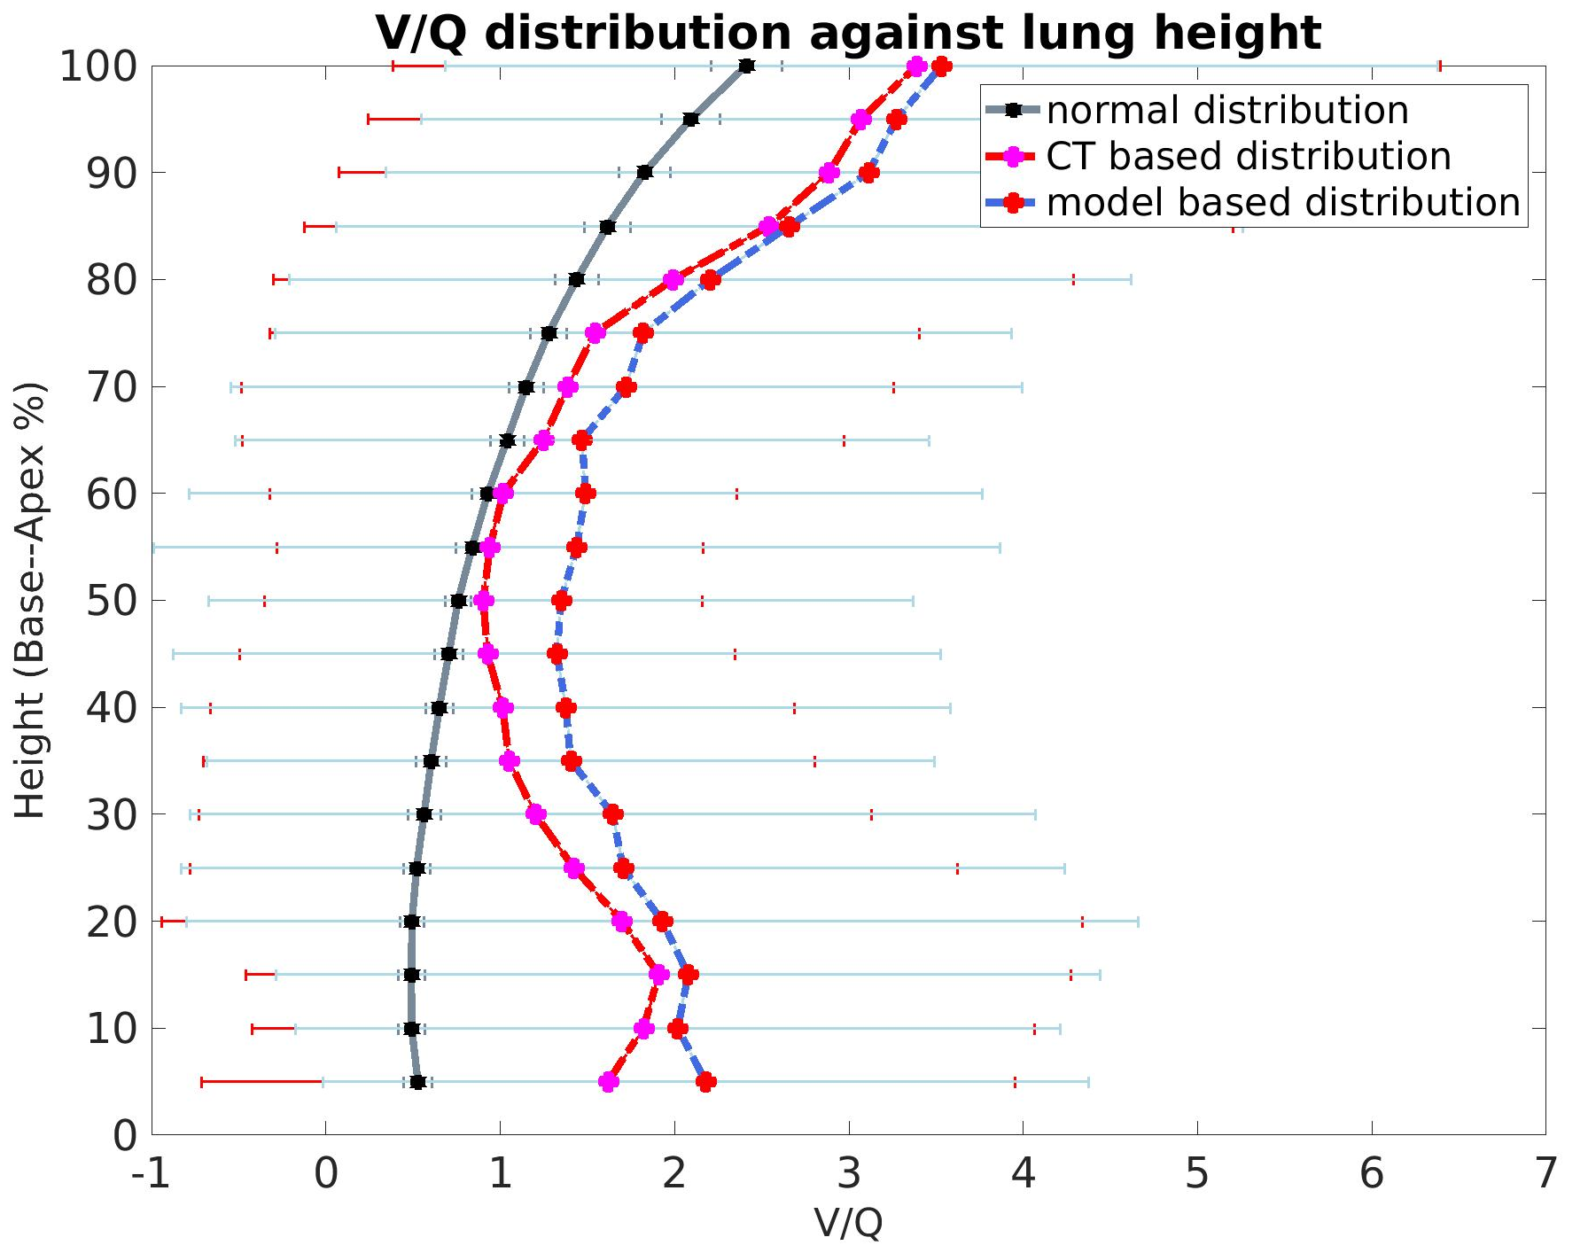
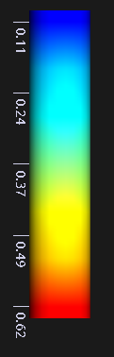
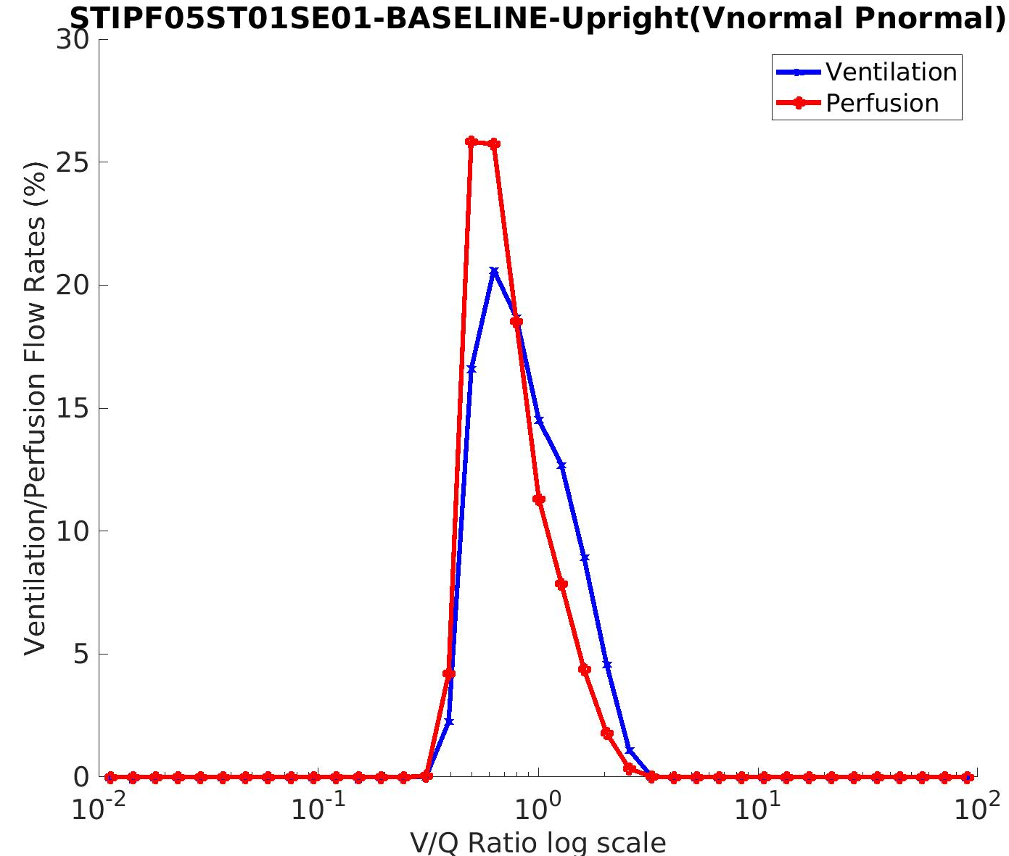
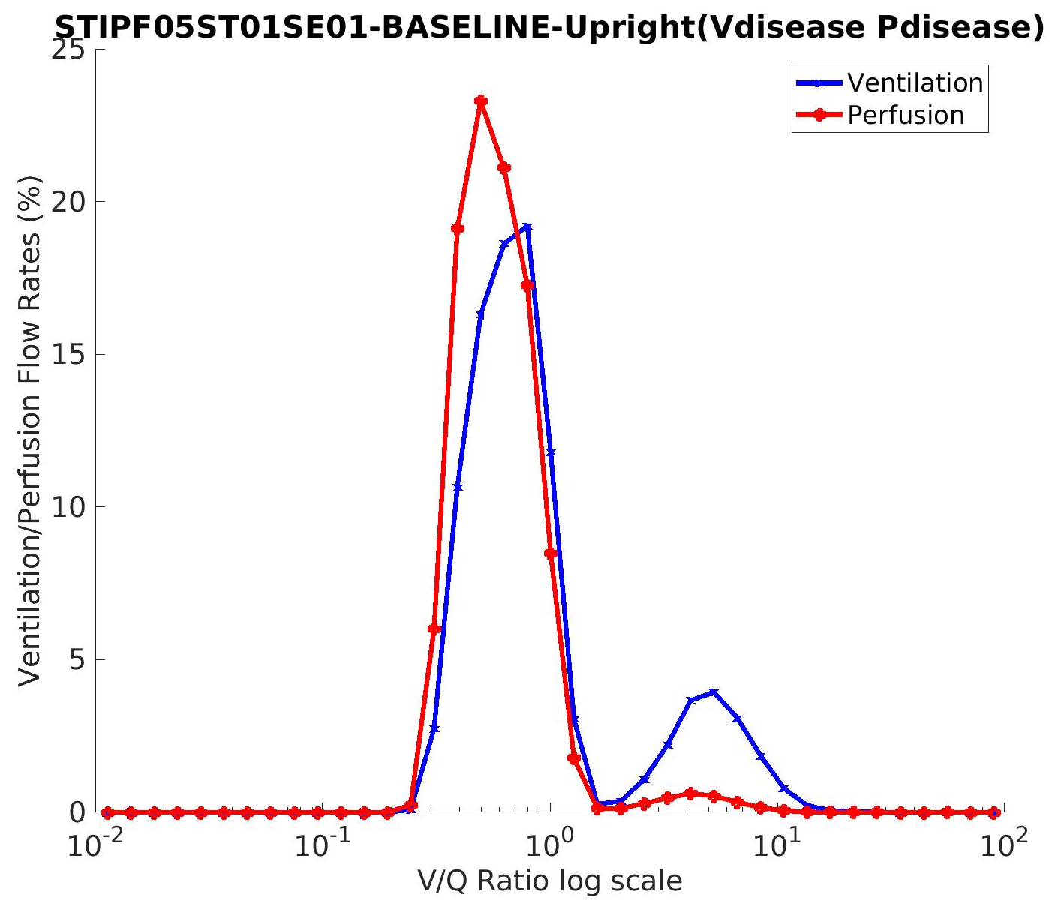
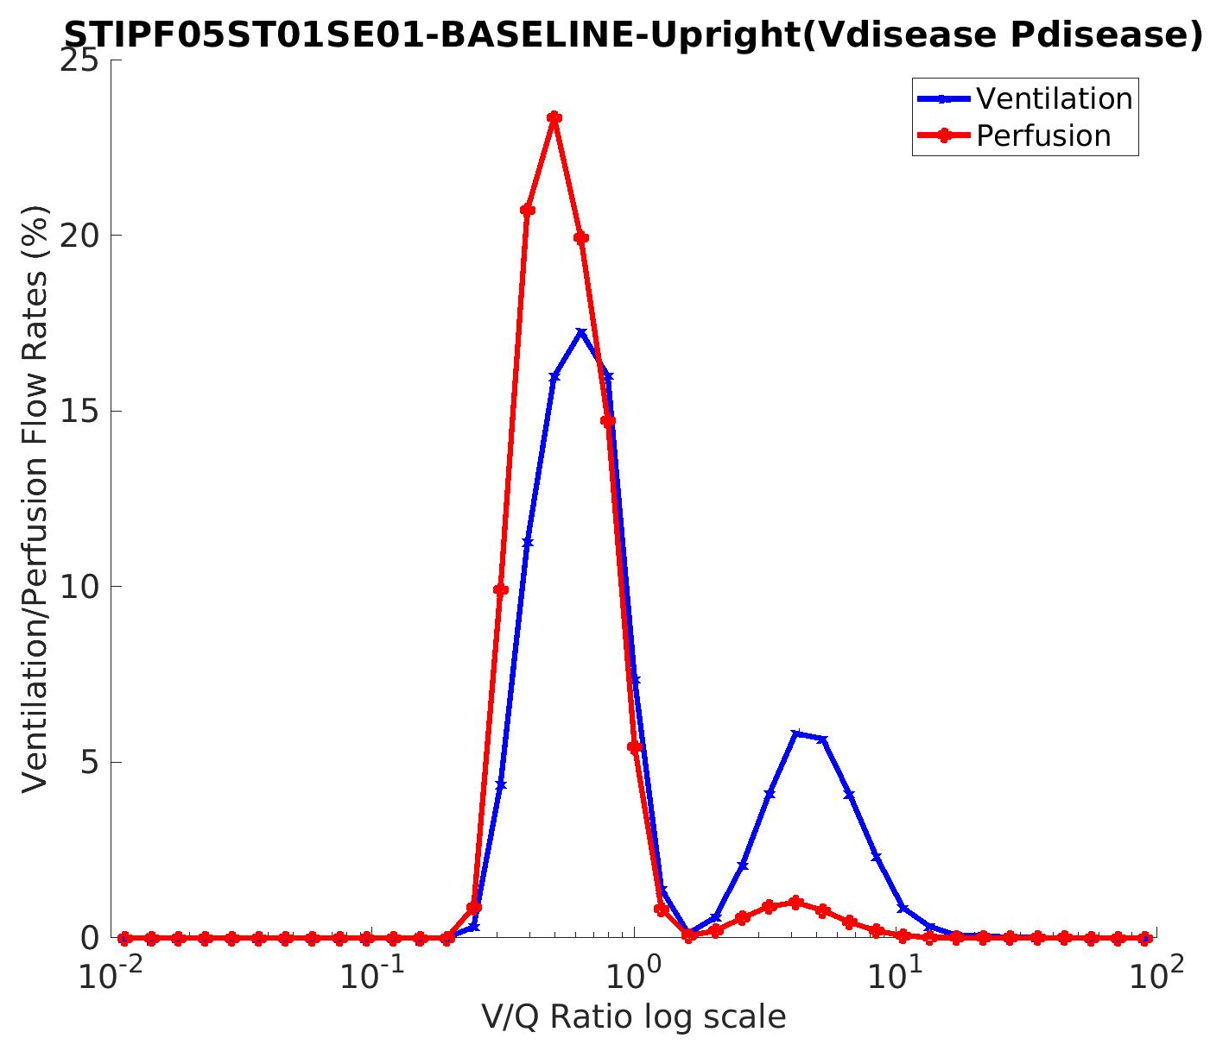
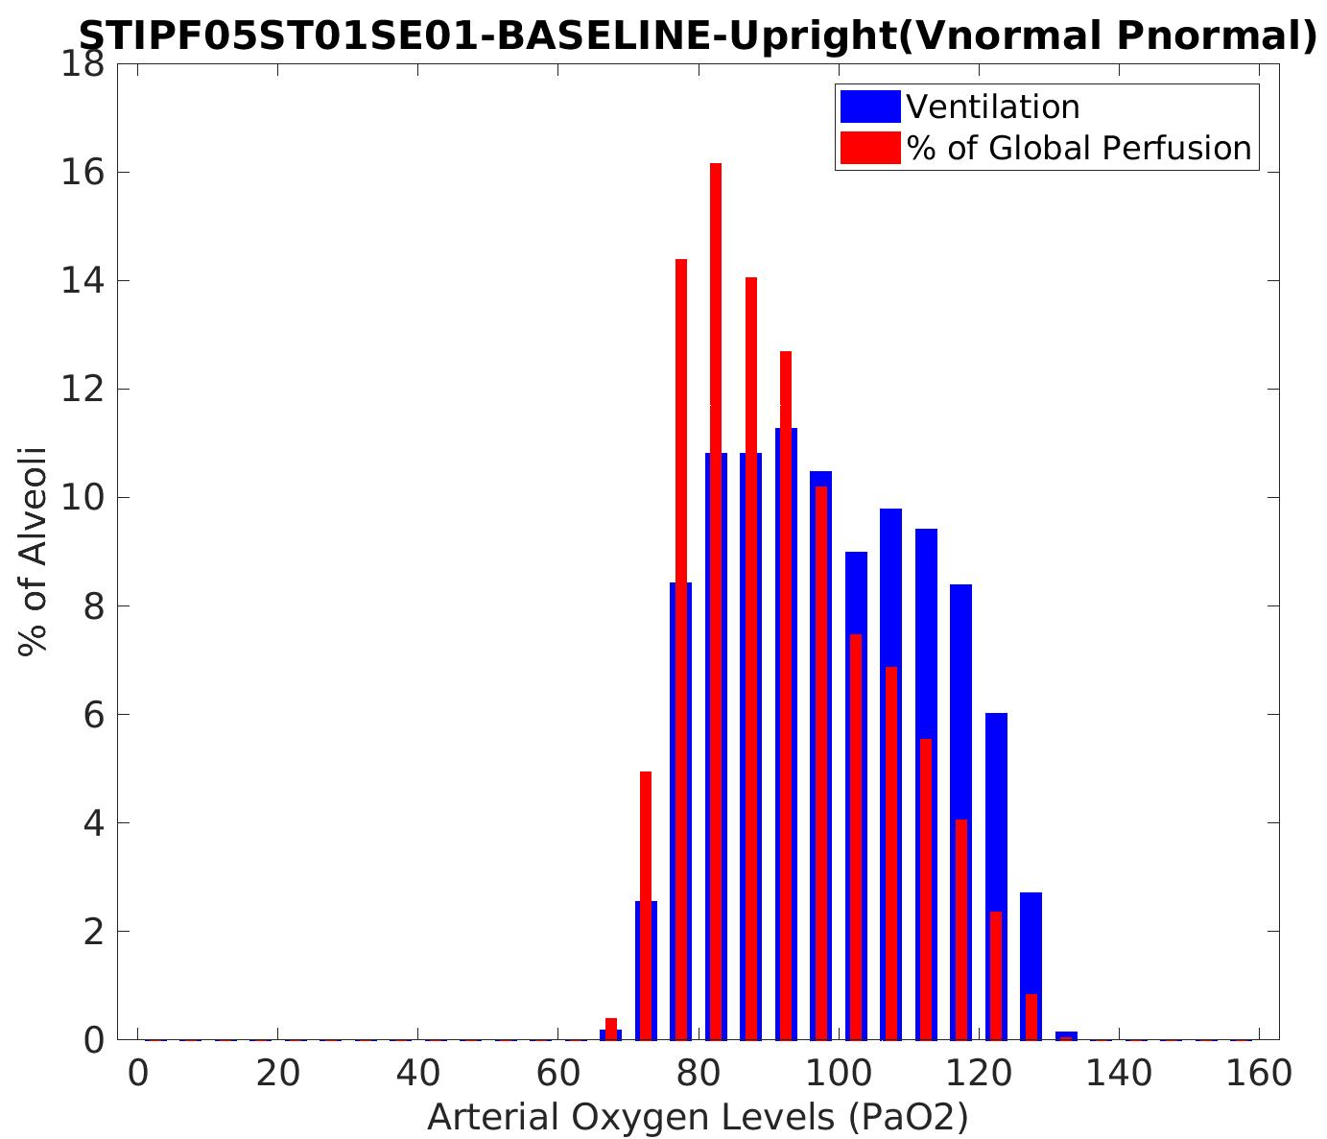
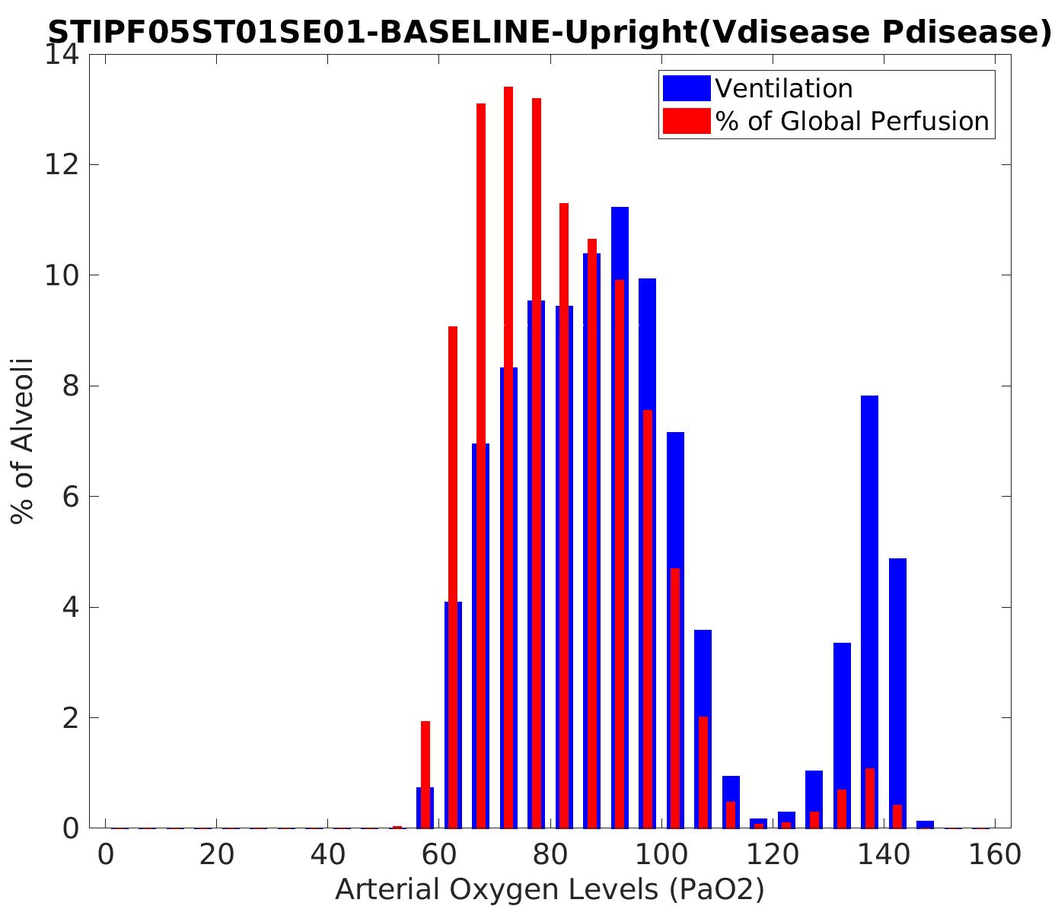
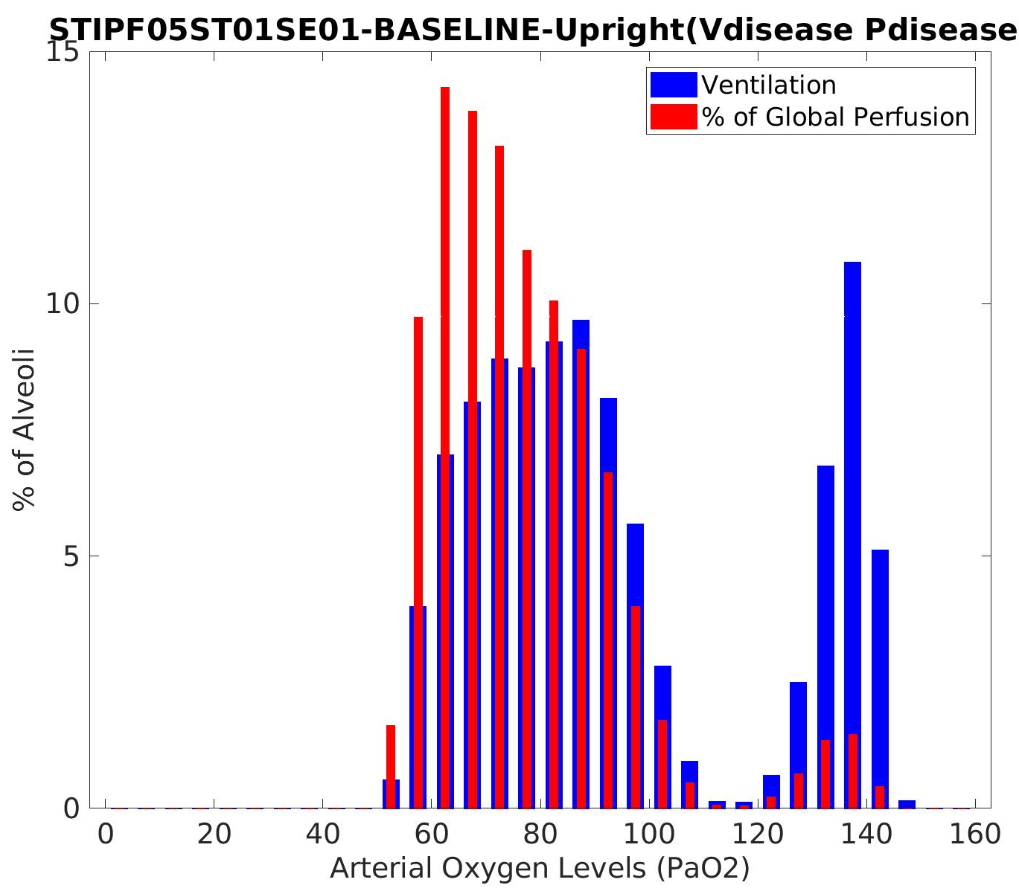
Idiopathic pulmonary fibrosis: a study using volumetric imaging and functional data in a computational lung model
Yuwen Zhang, Alys Clark, Haribalan Kumar , Merryn Tawhai, Auckland Bioengineering Institute, The University of Auckland, New Zealand
David Milne, Margaret Wilsher, Auckland City Hospital, Auckland, New Zealand
Brian Bartholmai, Department of Radiology, Mayo Clinic, Minnesota, US
Introduction
Analysis 1 Statistical shape model based shape analysis
Idiopathic pulmonary fibrosis (IPF) is an aggressive idiopathic interstitial pneumonia, and often occurs in elderly adults. In IPF, fibrosis typically develops preferentially in posterior-basal lung regions, and often co-exists with emphysema. Currently it is not clear how - or whether - the spatial distribution of tissue abnormalities in IPF (including classifications of tissue type) correlate with pulmonary function tests (PFTs) and their change over time. This work aims to develop a new quantitative tool that integrates data from volumetric imaging, PFTs, and computational models for lung function, to understand differences between IPF and normal older lungs.
Training data collection
Principle component shape feature analysis
Specific subject projection
Statistical shape model construction
Mode1 -3 SD
Mode1 -2 SD
Mode1 0 SD
Mode1 1 SD
Mode1 3 SD
Mode 1 of the SSM is significantly different between IPF and normal subjects and correlates with percent of fibrosis (p<0.01).
The most significant variation in shape (mode 1 of the SSM) relates to the anteroposterior diameter of the lung, and the ratio of apical and basal diameters
There is a significant difference of right lower lobe volume and right middle lobe volume between normal old and IPF lungs (p<0.001, p<0.001 respectively).
Tissue classification and quantification
Data- Clinical IPF CT data from Auckland City Hospital 8 patients, 4 of them contain more than one time point scan for each
Pulmonary parenchyma classification - CALIPER (Computer-Aided Lung Information for Pathology Evaluation and Ratings) classification of abnormalities based on signature mapping techniques
Analysis 2 Patient-specific computational modelling of lung function
Step1: Airway and vessel tree generation with disease labeling
Maunual digitize upper airway/vessel
Map upper airway/vessel to PCA predicted mesh of old normal lung
Generate full airway/vessel tree
Map full airway/vessel back to disease lobe mesh
Label airway/vessel tree with different tissue patterns
Step 2: Ventialtion and perfusion simulation
CT based fibrosis derived curve
Patient-specific perfusion
Deep inspiration using normal geometry and lung volume
Set patient-specific muscle pressure
CT based fibrosis: 17.64%
Real inspiration curve
Reduce vessel radius of fisbrosis labelled regions
Normal Ground-glass Reticular Honeycomb Emphysema
Predict model based real fibrosis distribution
Deep inspiration using disease geometry and lung volume
Model based Fibrosis: 29.75%
Inhale volume and pressure curve
Disease perfusion
Fibrosis has a consistently higher tissue density (0.34/0.41 for reticular/ground-glass) compared to normal tissue (0.28) over time. In contrast, emphysema has lower density (0.08)
Step 3: V/Q distribution (gas transfer modeling)
Summary
We classified the pulmonary parenchyma representing IPF features and performed quantitative analysis of IPF lungs.
Statistical shape analysis suggests quantifiable differences from normal in lung shape are present in IPF.
V/Q mismatch (impaired gas exchange) is present in ‘normal’ tissue as well as regions that are classified as abnormal.
Fibrosis presents predominantly in lower lobes (72%, 58%, 65% for honeycomb, reticular, ground-glass). But emphysema appears predominantly in upper lobes (73%).
Old normal
CT based
Model based
3D grid density visualization of tissue patterns
V/Q vertical distribution
Old normal
CT based
Model based
Old normal PaO2 89.02mm Hg
The distribution of fibrosis is basal, peripheral and pathy. The disease mostly occurs in small airways which causes peribronchiolar airway constriction.
CT based PaO2 is 78.11mm Hg
Acknowledgements – Clinical data for this study was provided by Drs ML Wilsher and DG Milne, Auckland City Hospital; CALIPER analysis was conducted by Dr B Bartholmai, The Mayo Clinic.
Model base PaO2 is 72.91mm Hg

